Slide 1
BCpr294
Final presentation
Team B

Slide 2
Quality Assurance
SQL Injection
XSS- Cross Site Scripting
CSRF- Cross Site Request Forgery

Slide 3
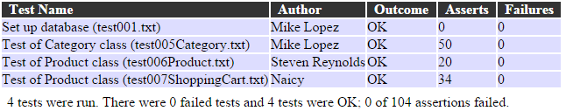

Slide 4
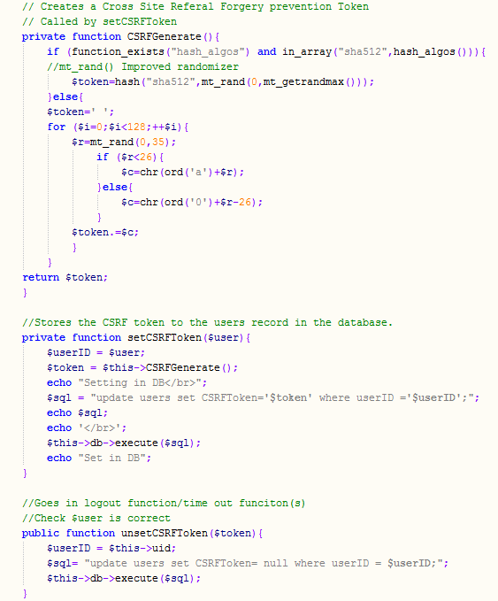
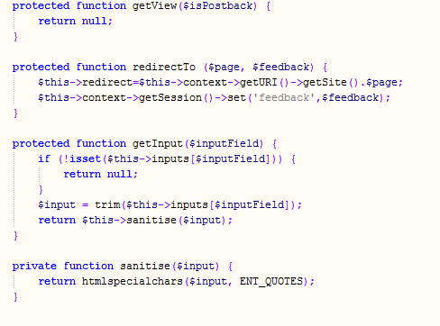

Slide 5
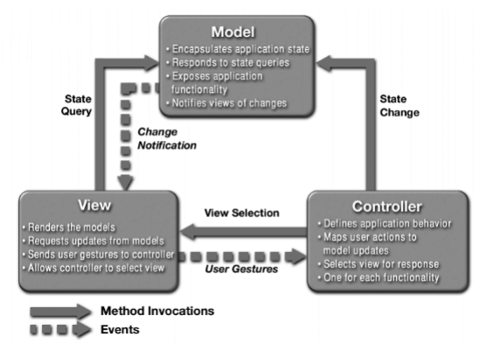
Architecture

Slide 6
Programming values
Separation Of Concerns(SOC)
Separation of Model, View, and Controller:
allows re-use of business-logic across applications
allows development of multiple UIs without touching business logic codebase
discourages "cut-&-paste" repetition of code, streamlining upgrade & maintenance tasks
Looking at the other side of the same coin, intermingling M, V, and C code makes for:
bigger, harder-to-maintain classes
repetition of code in multiple classes (upgrade & maintenance issues)

Slide 7
DRY (Don't repeat yourself)
The DRY principle is stated as “Every piece of knowledge must have a single, unambiguous, authoritative representation within a system.”
In model-driven architectures, in which software artifacts are derived from a central object model expressed in a form such as UML. DRY code is created by data transformation and code generators, which allows the software developer to avoid copy and paste operations. DRY code usually makes large software systems easier to maintain, as long as the data transformations are easy to create and maintain.

Slide 8
SOLID principles
Single responsibility- Every object in a class should have a single responsibility, and that should be encapsulated by that class
Open/closed responsibility- Open for extension ,but closed for modification
Liskov substitution – Objects in a program should be replaceable with the instances of the subclasses without altering the correctness of the program
Interface segregation- multiple specific interfaces are better than one general purpose interface
Dependency Inversion- Depends on abstractions and not on concretions.

Slide 9
Project experience
Scrum.
Github.
Moodle.
Google drive.
Blended Learning.

Slide 10
LEARNINGS AND TAKE AWAYS
To program DB connections solutions and web to DB interconnections in Php
Programme dynamic page generation for applications such as product displays, shopping cart and other online applications
To analyse the issues in server side programming
Design, implement and test small systems that require server side scripting
Use supplied classes for functionality such as DB connection and query

